Slide 1
Mathématiques en technologies de l’information

Slide 2
Mathématiques en technologies de l’information

Slide 3
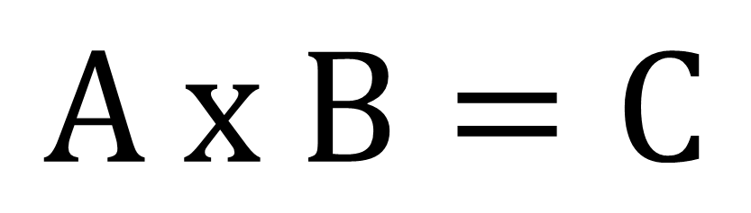
$$A x B=C$$

Slide 4
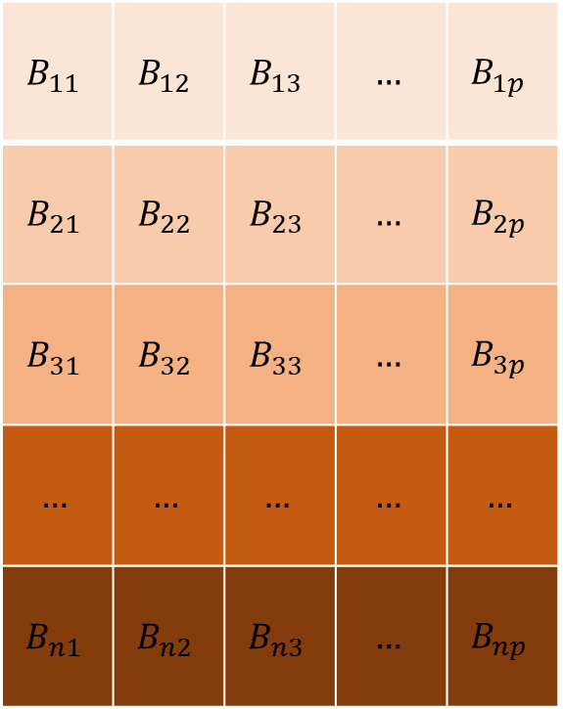
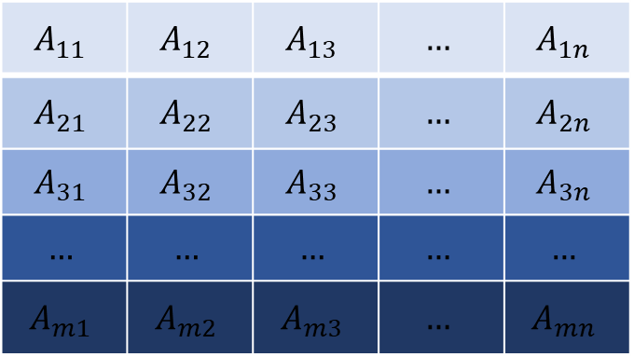



$$A$$
$$B$$
$$A_{11}$$ | $$A_{12}$$ | $$A_{13}$$ | $$…$$ | $$A_{1n}$$
$$A_{21}$$ | $$A_{22}$$ | $$A_{23}$$ | $$…$$ | $$A_{2n}$$
$$A_{31}$$ | $$A_{32}$$ | $$A_{33}$$ | $$…$$ | $$A_{3n}$$
$$…$$ | $$…$$ | $$…$$ | $$…$$ | $$…$$
$$A_{m1}$$ | $$A_{m2}$$ | $$A_{m3}$$ | $$…$$ | $$A_{mn}$$
$$B_{11}$$ | $$B_{12}$$ | $$B_{13}$$ | $$…$$ | $$B_{1p}$$
$$B_{21}$$ | $$B_{22}$$ | $$B_{23}$$ | $$…$$ | $$B_{2p}$$
$$B_{31}$$ | $$B_{32}$$ | $$B_{33}$$ | $$…$$ | $$B_{3p}$$
$$…$$ | $$…$$ | $$…$$ | $$…$$ | $$…$$
$$B_{n1}$$ | $$B_{n2}$$ | $$B_{n3}$$ | $$…$$ | $$B_{np}$$
$$X$$

Slide 5
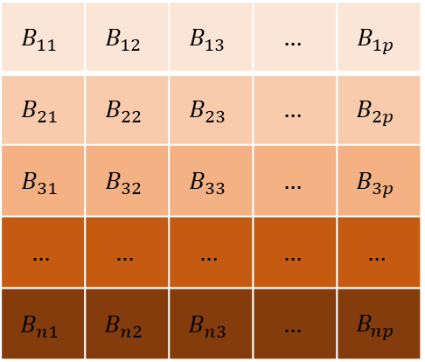
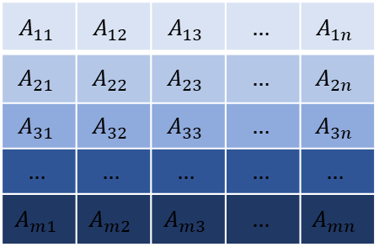

$$A_{11}$$ | $$A_{12}$$ | $$A_{13}$$ | $$…$$ | $$A_{1n}$$
$$A_{21}$$ | $$A_{22}$$ | $$A_{23}$$ | $$…$$ | $$A_{2n}$$
$$A_{31}$$ | $$A_{32}$$ | $$A_{33}$$ | $$…$$ | $$A_{3n}$$
$$…$$ | $$…$$ | $$…$$ | $$…$$ | $$…$$
$$A_{m1}$$ | $$A_{m2}$$ | $$A_{m3}$$ | $$…$$ | $$A_{mn}$$
$$B_{11}$$ | $$B_{12}$$ | $$B_{13}$$ | $$…$$ | $$B_{1p}$$
$$B_{21}$$ | $$B_{22}$$ | $$B_{23}$$ | $$…$$ | $$B_{2p}$$
$$B_{31}$$ | $$B_{32}$$ | $$B_{33}$$ | $$…$$ | $$B_{3p}$$
$$…$$ | $$…$$ | $$…$$ | $$…$$ | $$…$$
$$B_{n1}$$ | $$B_{n2}$$ | $$B_{n3}$$ | $$…$$ | $$B_{np}$$
$$X$$

Slide 6

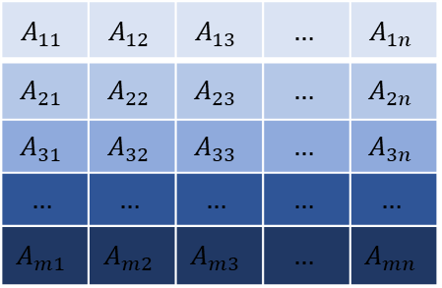
$$B_{11}$$ | $$B_{12}$$ | $$B_{13}$$ | $$…$$ | $$B_{1p}$$
$$B_{21}$$ | $$B_{22}$$ | $$B_{23}$$ | $$…$$ | $$B_{2p}$$
$$B_{31}$$ | $$B_{32}$$ | $$B_{33}$$ | $$…$$ | $$B_{3p}$$
$$…$$ | $$…$$ | $$…$$ | $$…$$ | $$…$$
$$B_{n1}$$ | $$B_{n2}$$ | $$B_{n3}$$ | $$…$$ | $$B_{np}$$
$$A_{11}$$ | $$A_{12}$$ | $$A_{13}$$ | $$…$$ | $$A_{1n}$$
$$A_{21}$$ | $$A_{22}$$ | $$A_{23}$$ | $$…$$ | $$A_{2n}$$
$$A_{31}$$ | $$A_{32}$$ | $$A_{33}$$ | $$…$$ | $$A_{3n}$$
$$…$$ | $$…$$ | $$…$$ | $$…$$ | $$…$$
$$A_{m1}$$ | $$A_{m2}$$ | $$A_{m3}$$ | $$…$$ | $$A_{mn}$$

Slide 7
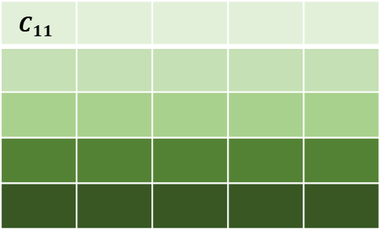
$$B_{11}$$ | $$B_{12}$$ | $$B_{13}$$ | $$…$$ | $$B_{1p}$$
$$B_{21}$$ | $$B_{22}$$ | $$B_{23}$$ | $$…$$ | $$B_{2p}$$
$$B_{31}$$ | $$B_{32}$$ | $$B_{33}$$ | $$…$$ | $$B_{3p}$$
$$…$$ | $$…$$ | $$…$$ | $$…$$ | $$…$$
$$B_{n1}$$ | $$B_{n2}$$ | $$B_{n3}$$ | $$…$$ | $$B_{np}$$
$$A_{11}$$ | $$A_{12}$$ | $$A_{13}$$ | $$…$$ | $$A_{1n}$$
$$A_{21}$$ | $$A_{22}$$ | $$A_{23}$$ | $$…$$ | $$A_{2n}$$
$$A_{31}$$ | $$A_{32}$$ | $$A_{33}$$ | $$…$$ | $$A_{3n}$$
$$…$$ | $$…$$ | $$…$$ | $$…$$ | $$…$$
$$A_{m1}$$ | $$A_{m2}$$ | $$A_{m3}$$ | $$…$$ | $$A_{mn}$$
$$C_{11}$$
$$C_{11}=A_{11}×B_{11}+A_{12}×B_{21}+…+A_{1n}×B_{n1}$$

Slide 8
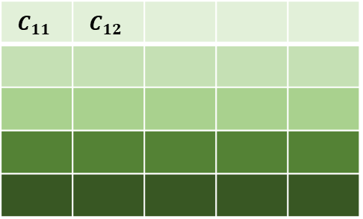
$$B_{11}$$ | $$B_{12}$$ | $$B_{13}$$ | $$…$$ | $$B_{1p}$$
$$B_{21}$$ | $$B_{22}$$ | $$B_{23}$$ | $$…$$ | $$B_{2p}$$
$$B_{31}$$ | $$B_{32}$$ | $$B_{33}$$ | $$…$$ | $$B_{3p}$$
$$…$$ | $$…$$ | $$…$$ | $$…$$ | $$…$$
$$B_{n1}$$ | $$B_{n2}$$ | $$B_{n3}$$ | $$…$$ | $$B_{np}$$
$$A_{11}$$ | $$A_{12}$$ | $$A_{13}$$ | $$…$$ | $$A_{1n}$$
$$A_{21}$$ | $$A_{22}$$ | $$A_{23}$$ | $$…$$ | $$A_{2n}$$
$$A_{31}$$ | $$A_{32}$$ | $$A_{33}$$ | $$…$$ | $$A_{3n}$$
$$…$$ | $$…$$ | $$…$$ | $$…$$ | $$…$$
$$A_{m1}$$ | $$A_{m2}$$ | $$A_{m3}$$ | $$…$$ | $$A_{mn}$$
$$C_{11}$$ | $$C_{12}$$
$$C_{12}=A_{11}×B_{12}+A_{12}×B_{22}+…+A_{1n}×B_{n2}$$

Slide 9
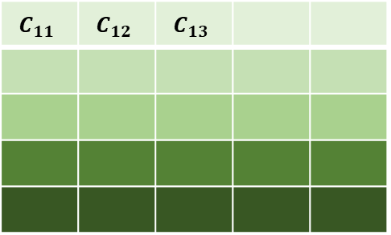
$$B_{11}$$ | $$B_{12}$$ | $$B_{13}$$ | $$…$$ | $$B_{1p}$$
$$B_{21}$$ | $$B_{22}$$ | $$B_{23}$$ | $$…$$ | $$B_{2p}$$
$$B_{31}$$ | $$B_{32}$$ | $$B_{33}$$ | $$…$$ | $$B_{3p}$$
$$…$$ | $$…$$ | $$…$$ | $$…$$ | $$…$$
$$B_{n1}$$ | $$B_{n2}$$ | $$B_{n3}$$ | $$…$$ | $$B_{np}$$
$$A_{11}$$ | $$A_{12}$$ | $$A_{13}$$ | $$…$$ | $$A_{1n}$$
$$A_{21}$$ | $$A_{22}$$ | $$A_{23}$$ | $$…$$ | $$A_{2n}$$
$$A_{31}$$ | $$A_{32}$$ | $$A_{33}$$ | $$…$$ | $$A_{3n}$$
$$…$$ | $$…$$ | $$…$$ | $$…$$ | $$…$$
$$A_{m1}$$ | $$A_{m2}$$ | $$A_{m3}$$ | $$…$$ | $$A_{mn}$$
$$C_{11}$$ | $$C_{12}$$ | $$C_{13}$$
$$C_{13}=A_{11}×B_{13}+A_{12}×B_{23}+…+A_{1n}×B_{n3}$$

Slide 10
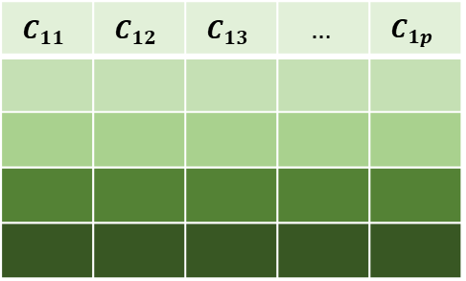
$$B_{11}$$ | $$B_{12}$$ | $$B_{13}$$ | $$…$$ | $$B_{1p}$$
$$B_{21}$$ | $$B_{22}$$ | $$B_{23}$$ | $$…$$ | $$B_{2p}$$
$$B_{31}$$ | $$B_{32}$$ | $$B_{33}$$ | $$…$$ | $$B_{3p}$$
$$…$$ | $$…$$ | $$…$$ | $$…$$ | $$…$$
$$B_{n1}$$ | $$B_{n2}$$ | $$B_{n3}$$ | $$…$$ | $$B_{np}$$
$$A_{11}$$ | $$A_{12}$$ | $$A_{13}$$ | $$…$$ | $$A_{1n}$$
$$A_{21}$$ | $$A_{22}$$ | $$A_{23}$$ | $$…$$ | $$A_{2n}$$
$$A_{31}$$ | $$A_{32}$$ | $$A_{33}$$ | $$…$$ | $$A_{3n}$$
$$…$$ | $$…$$ | $$…$$ | $$…$$ | $$…$$
$$A_{m1}$$ | $$A_{m2}$$ | $$A_{m3}$$ | $$…$$ | $$A_{mn}$$
$$C_{11}$$ | $$C_{12}$$ | $$C_{13}$$ | $$…$$ | $$C_{1p}$$
$$C_{1p}=A_{11}×B_{1p}+A_{12}×B_{2p}+…+A_{1n}×B_{np}$$

Slide 11
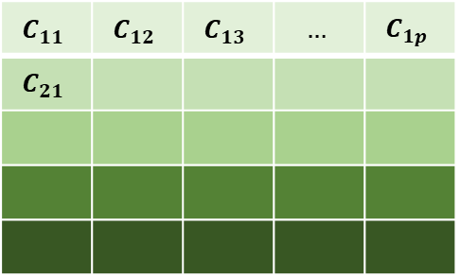
$$B_{11}$$ | $$B_{12}$$ | $$B_{13}$$ | $$…$$ | $$B_{1p}$$
$$B_{21}$$ | $$B_{22}$$ | $$B_{23}$$ | $$…$$ | $$B_{2p}$$
$$B_{31}$$ | $$B_{32}$$ | $$B_{33}$$ | $$…$$ | $$B_{3p}$$
$$…$$ | $$…$$ | $$…$$ | $$…$$ | $$…$$
$$B_{n1}$$ | $$B_{n2}$$ | $$B_{n3}$$ | $$…$$ | $$B_{np}$$
$$A_{11}$$ | $$A_{12}$$ | $$A_{13}$$ | $$…$$ | $$A_{1n}$$
$$A_{21}$$ | $$A_{22}$$ | $$A_{23}$$ | $$…$$ | $$A_{2n}$$
$$A_{31}$$ | $$A_{32}$$ | $$A_{33}$$ | $$…$$ | $$A_{3n}$$
$$…$$ | $$…$$ | $$…$$ | $$…$$ | $$…$$
$$A_{m1}$$ | $$A_{m2}$$ | $$A_{m3}$$ | $$…$$ | $$A_{mn}$$
$$C_{11}$$ | $$C_{12}$$ | $$C_{13}$$ | $$…$$ | $$C_{1p}$$
$$C_{21}$$
$$C_{21}=A_{21}×B_{12}+A_{22}×B_{21}+…+A_{2n}×B_{n1}$$

Slide 12
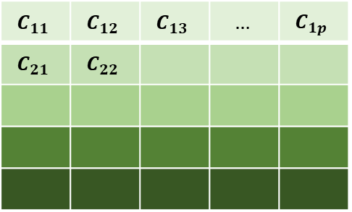
$$B_{11}$$ | $$B_{12}$$ | $$B_{13}$$ | $$…$$ | $$B_{1p}$$
$$B_{21}$$ | $$B_{22}$$ | $$B_{23}$$ | $$…$$ | $$B_{2p}$$
$$B_{31}$$ | $$B_{32}$$ | $$B_{33}$$ | $$…$$ | $$B_{3p}$$
$$…$$ | $$…$$ | $$…$$ | $$…$$ | $$…$$
$$B_{n1}$$ | $$B_{n2}$$ | $$B_{n3}$$ | $$…$$ | $$B_{np}$$
$$A_{11}$$ | $$A_{12}$$ | $$A_{13}$$ | $$…$$ | $$A_{1n}$$
$$A_{21}$$ | $$A_{22}$$ | $$A_{23}$$ | $$…$$ | $$A_{2n}$$
$$A_{31}$$ | $$A_{32}$$ | $$A_{33}$$ | $$…$$ | $$A_{3n}$$
$$…$$ | $$…$$ | $$…$$ | $$…$$ | $$…$$
$$A_{m1}$$ | $$A_{m2}$$ | $$A_{m3}$$ | $$…$$ | $$A_{mn}$$
$$C_{11}$$ | $$C_{12}$$ | $$C_{13}$$ | $$…$$ | $$C_{1p}$$
$$C_{21}$$ | $$C_{22}$$
$$C_{22}=A_{21}×B_{12}+A_{22}×B_{22}+…+A_{2n}×B_{n2}$$

Slide 13

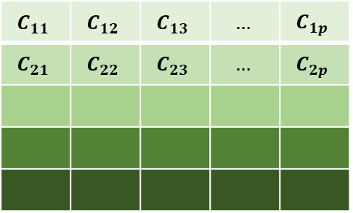
$$B_{11}$$ | $$B_{12}$$ | $$B_{13}$$ | $$…$$ | $$B_{1p}$$
$$B_{21}$$ | $$B_{22}$$ | $$B_{23}$$ | $$…$$ | $$B_{2p}$$
$$B_{31}$$ | $$B_{32}$$ | $$B_{33}$$ | $$…$$ | $$B_{3p}$$
$$…$$ | $$…$$ | $$…$$ | $$…$$ | $$…$$
$$B_{n1}$$ | $$B_{n2}$$ | $$B_{n3}$$ | $$…$$ | $$B_{np}$$
$$A_{11}$$ | $$A_{12}$$ | $$A_{13}$$ | $$…$$ | $$A_{1n}$$
$$A_{21}$$ | $$A_{22}$$ | $$A_{23}$$ | $$…$$ | $$A_{2n}$$
$$A_{31}$$ | $$A_{32}$$ | $$A_{33}$$ | $$…$$ | $$A_{3n}$$
$$…$$ | $$…$$ | $$…$$ | $$…$$ | $$…$$
$$A_{m1}$$ | $$A_{m2}$$ | $$A_{m3}$$ | $$…$$ | $$A_{mn}$$
$$C_{22}$$
$$C_{11}$$ | $$C_{12}$$ | $$C_{13}$$ | $$…$$ | $$C_{1p}$$
$$C_{21}$$ | $$C_{22}$$ | $$C_{23}$$ | $$…$$ | $$C_{2p}$$
$$C_{2p}=A_{21}×B_{1p}+A_{22}×B_{2p}+…+A_{2n}×B_{np}$$

Slide 14
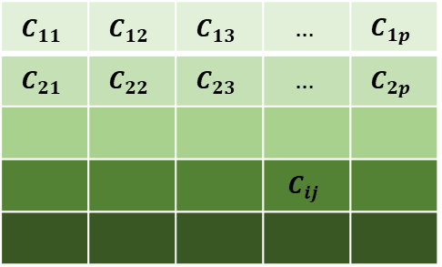
$$B_{11}$$ | $$B_{12}$$ | $$B_{13}$$ | $$…$$ | $$B_{1p}$$
$$B_{21}$$ | $$B_{22}$$ | $$B_{23}$$ | $$…$$ | $$B_{2p}$$
$$B_{31}$$ | $$B_{32}$$ | $$B_{33}$$ | $$…$$ | $$B_{3p}$$
$$…$$ | $$…$$ | $$…$$ | $$…$$ | $$…$$
$$B_{n1}$$ | $$B_{n2}$$ | $$B_{n3}$$ | $$…$$ | $$B_{np}$$
$$A_{11}$$ | $$A_{12}$$ | $$A_{13}$$ | $$…$$ | $$A_{1n}$$
$$A_{21}$$ | $$A_{22}$$ | $$A_{23}$$ | $$…$$ | $$A_{2n}$$
$$A_{31}$$ | $$A_{32}$$ | $$A_{33}$$ | $$…$$ | $$A_{3n}$$
$$…$$ | $$…$$ | $$…$$ | $$…$$ | $$…$$
$$A_{m1}$$ | $$A_{m2}$$ | $$A_{m3}$$ | $$…$$ | $$A_{mn}$$
$$C_{22}$$
$$C_{11}$$ | $$C_{12}$$ | $$C_{13}$$ | $$…$$ | $$C_{1p}$$
$$C_{21}$$ | $$C_{22}$$ | $$C_{23}$$ | $$…$$ | $$C_{2p}$$
 |  |  | $$C_{ij}$$
$$C_{ij}=A_{i1}×B_{1j}+A_{i2}×B_{2j}+…+A_{in}×B_{nj}$$

Slide 15
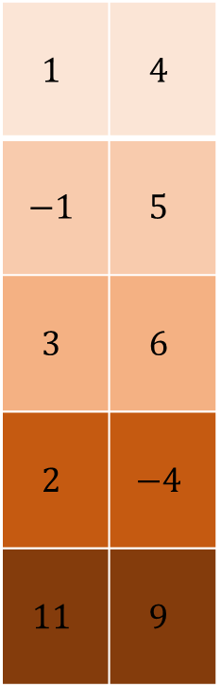
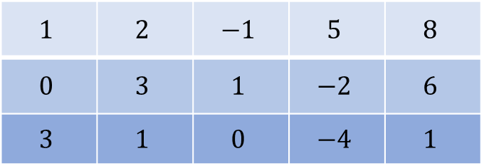
$$A$$
$$B$$
$$1$$ | $$2$$ | $$−1$$ | $$5$$ | $$8$$
$$0$$ | $$3$$ | $$1$$ | $$−2$$ | $$6$$
$$3$$ | $$1$$ | $$0$$ | $$−4$$ | $$1$$
$$1$$ | $$4$$
$$−1$$ | $$5$$
$$3$$ | $$6$$
$$2$$ | $$−4$$
$$11$$ | $$9$$
$$X$$

Slide 16
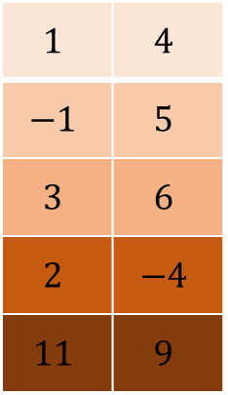
$$1$$ | $$2$$ | $$−1$$ | $$5$$ | $$8$$
$$0$$ | $$3$$ | $$1$$ | $$−2$$ | $$6$$
$$3$$ | $$1$$ | $$0$$ | $$−4$$ | $$1$$
$$1$$ | $$4$$
$$−1$$ | $$5$$
$$3$$ | $$6$$
$$2$$ | $$−4$$
$$11$$ | $$9$$

Slide 17
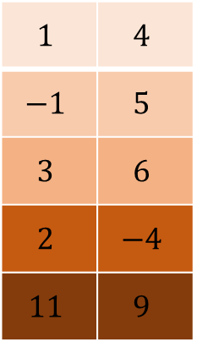
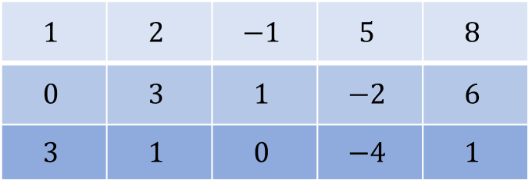
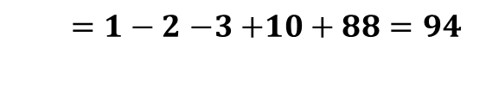
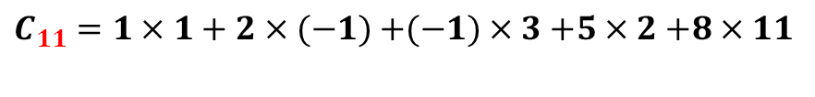
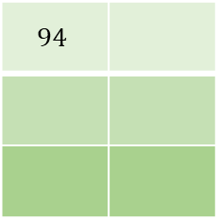
$$1$$ | $$4$$
$$−1$$ | $$5$$
$$3$$ | $$6$$
$$2$$ | $$−4$$
$$11$$ | $$9$$
$$1$$ | $$2$$ | $$−1$$ | $$5$$ | $$8$$
$$0$$ | $$3$$ | $$1$$ | $$−2$$ | $$6$$
$$3$$ | $$1$$ | $$0$$ | $$−4$$ | $$1$$
$$94$$
$C_{11}=1×1+2×(−1)$ $+(−1)×3$ $+5×2$ $+8×11$
$=1−2$ $−3$ $+10+88=94$

Slide 18
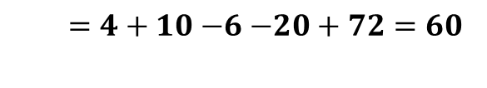
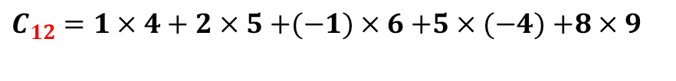
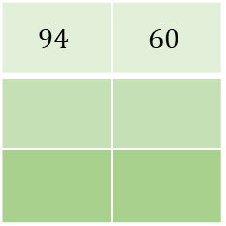
$$1$$ | $$4$$
$$−1$$ | $$5$$
$$3$$ | $$6$$
$$2$$ | $$−4$$
$$11$$ | $$9$$
$$1$$ | $$2$$ | $$−1$$ | $$5$$ | $$8$$
$$0$$ | $$3$$ | $$1$$ | $$−2$$ | $$6$$
$$3$$ | $$1$$ | $$0$$ | $$−4$$ | $$1$$
$$94$$ | $$60$$
$C_{12}=1×4+2×5$ $+(−1)×6$ $+5×(−4)$ $+8×9$
$=4+10$ $−6$ $−20+72=60$

Slide 19
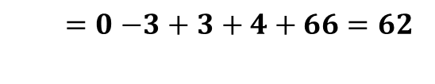
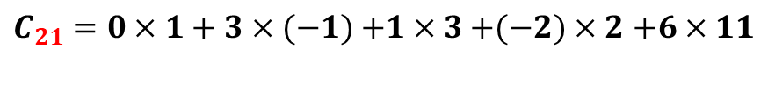
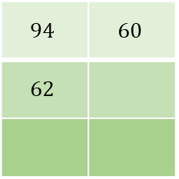
$$1$$ | $$4$$
$$−1$$ | $$5$$
$$3$$ | $$6$$
$$2$$ | $$−4$$
$$11$$ | $$9$$
$$1$$ | $$2$$ | $$−1$$ | $$5$$ | $$8$$
$$0$$ | $$3$$ | $$1$$ | $$−2$$ | $$6$$
$$3$$ | $$1$$ | $$0$$ | $$−4$$ | $$1$$
$$94$$ | $$60$$
$$62$$
$C_{21}=0×1+3×(−1)$ $+1×3$ $+(−2)×2$ $+6×11$
$=0$ $−3$ $+ 3+4+66=62$

Slide 20
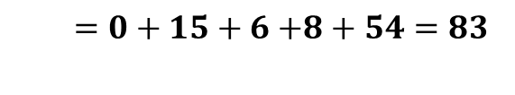
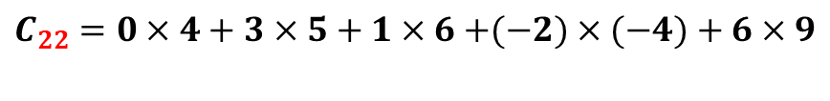
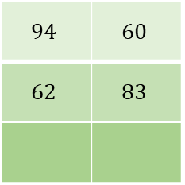
$$1$$ | $$4$$
$$−1$$ | $$5$$
$$3$$ | $$6$$
$$2$$ | $$−4$$
$$11$$ | $$9$$
$$1$$ | $$2$$ | $$−1$$ | $$5$$ | $$8$$
$$0$$ | $$3$$ | $$1$$ | $$−2$$ | $$6$$
$$3$$ | $$1$$ | $$0$$ | $$−4$$ | $$1$$
$$94$$ | $$60$$
$$62$$ | $$83$$
$C_{22}=0×4+3×5$ $+ 1×6$ $+(−2)×(−4)$ $+ 6×9$
$=0+15$ $+ 6$ $+8+54=83$

Slide 21
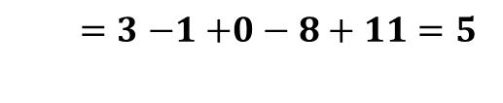
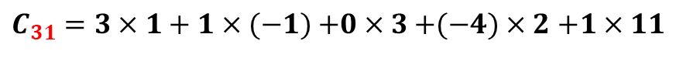
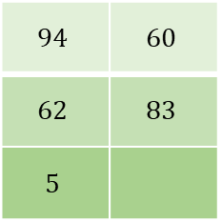
$$1$$ | $$4$$
$$−1$$ | $$5$$
$$3$$ | $$6$$
$$2$$ | $$−4$$
$$11$$ | $$9$$
$$1$$ | $$2$$ | $$−1$$ | $$5$$ | $$8$$
$$0$$ | $$3$$ | $$1$$ | $$−2$$ | $$6$$
$$3$$ | $$1$$ | $$0$$ | $$−4$$ | $$1$$
$$94$$ | $$60$$
$$62$$ | $$83$$
$$5$$
$C_{31}=3×1+1×(−1)$ $+0×3$ $+(−4)×2$ $+1×11$
$=3$ $−1$ $+0−8+11=5$

Slide 22
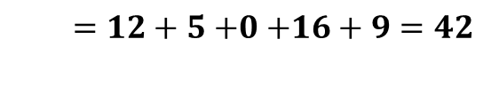
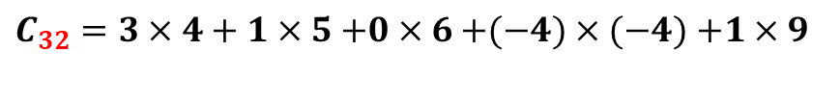
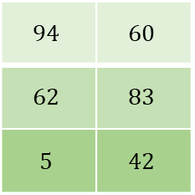
$$1$$ | $$4$$
$$−1$$ | $$5$$
$$3$$ | $$6$$
$$2$$ | $$−4$$
$$11$$ | $$9$$
$$1$$ | $$2$$ | $$−1$$ | $$5$$ | $$8$$
$$0$$ | $$3$$ | $$1$$ | $$−2$$ | $$6$$
$$3$$ | $$1$$ | $$0$$ | $$−4$$ | $$1$$
$$94$$ | $$60$$
$$62$$ | $$83$$
$$5$$ | $$42$$
$C_{32}=3×4+1×5$ $+0×6$ $+(−4)×(−4)$ $+1×9$
$=12+5$ $+0$ $+16+9=42$

Slide 23

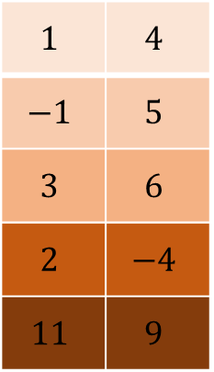

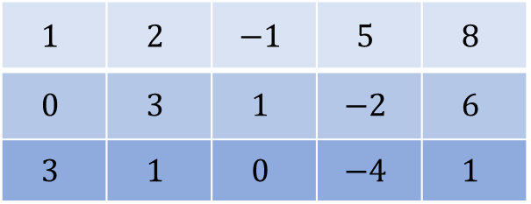


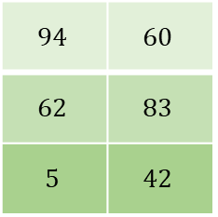

$$A$$
$$B$$
$$C$$
$$1$$ | $$2$$ | $$−1$$ | $$5$$ | $$8$$
$$0$$ | $$3$$ | $$1$$ | $$−2$$ | $$6$$
$$3$$ | $$1$$ | $$0$$ | $$−4$$ | $$1$$
$$1$$ | $$4$$
$$−1$$ | $$5$$
$$3$$ | $$6$$
$$2$$ | $$−4$$
$$11$$ | $$9$$
$$94$$ | $$60$$
$$62$$ | $$83$$
$$5$$ | $$42$$
$$X$$
$$=$$

Slide 24
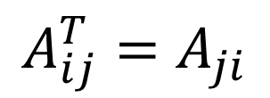

Transposée d’une matrice
La transposée d’une matrice $A,$notée $A^{T}$, s’obtient par symétrie axiale par rapport à la diagonale principale. Autrement dit
$$A_{ij}^{T}=A_{ji}$$

Slide 25
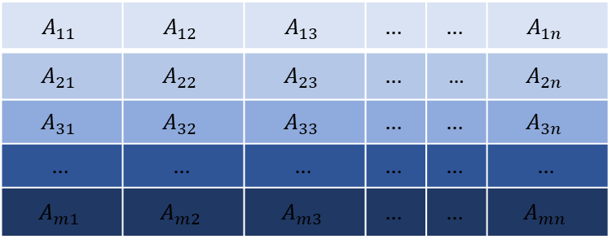
Transposée d’une matrice
$$A_{11}$$ | $$A_{12}$$ | $$A_{13}$$ | $$…$$ | $$…$$ | $$A_{1n}$$
$$A_{21}$$ | $$A_{22}$$ | $$A_{23}$$ | $$…$$ | … | $$A_{2n}$$
$$A_{31}$$ | $$A_{32}$$ | $$A_{33}$$ | $$…$$ | $$…$$ | $$A_{3n}$$
$$…$$ | $$…$$ | $$…$$ | $$…$$ | $$…$$ | $$…$$
$$A_{m1}$$ | $$A_{m2}$$ | $$A_{m3}$$ | $$…$$ | $$…$$ | $$A_{mn}$$

Slide 26
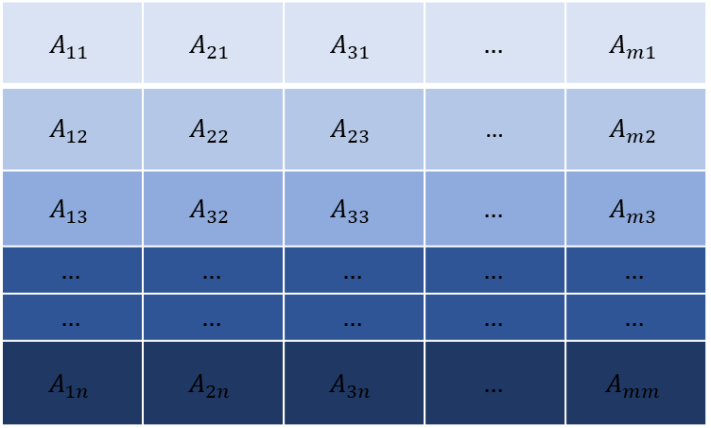
$$A_{11}$$ | $$A_{21}$$ | $$A_{31}$$ | $$…$$ | $$A_{m1}$$
$$A_{12}$$ | $$A_{22}$$ | $$A_{23}$$ | … | $$A_{m2}$$
$$A_{13}$$ | $$A_{32}$$ | $$A_{33}$$ | $$…$$ | $$A_{m3}$$
$$…$$ | $$…$$ | $$…$$ | $$…$$ | $$…$$
$$…$$ | $$…$$ | $$…$$ | $$…$$ | $$…$$
$$A_{1n}$$ | $$A_{2n}$$ | $$A_{3n}$$ | $$…$$ | $$A_{mm}$$

Slide 27
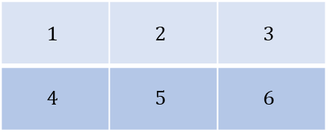
Exercice: transposez la matrice suivante
$$1$$ | $$2$$ | $$3$$
$$4$$ | $$5$$ | $$6$$

Slide 28
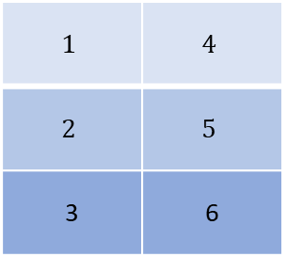
$$1$$ | $$4$$
$$2$$ | $$5$$
3 | 6

Slide 29
Inversibilité d’une matrice

Slide 30

Une matrice est dite inversible s’il existe une matrice inverse telle que
$$A A^{−1}=A^{−1} A=I_{n}$$

Slide 31
Notes:
La matrice doit être carrée,
Le déterminant de la matrice doit être non-nul.

Slide 32
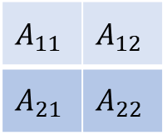

Déterminant 2x2:
Soit $A$ une matrice carrée de taille $2 ×2$, nous définissons le déterminant de la matrice $A$ comme
$$det\left(A\right)=\left|A\right|=a_{11}⋅a_{22}−a_{21}⋅a_{12}$$
$$A_{11}$$ | $$A_{12}$$
$$A_{21}$$ | $$A_{22}$$

Slide 33
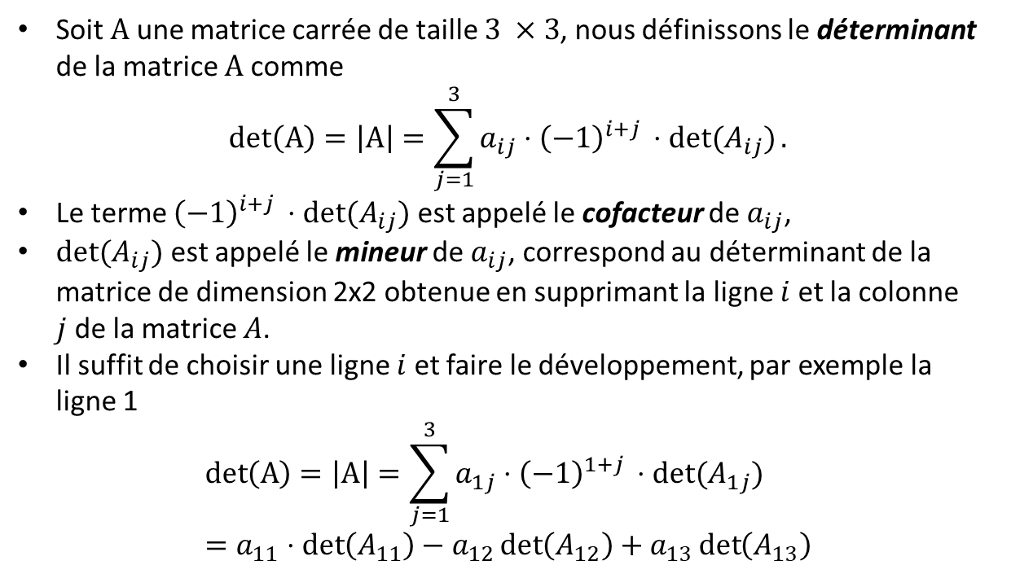
Déterminant 3x3:
Soit $A$ une matrice carrée de taille $3 ×3$, nous définissons le déterminant de la matrice $A$ comme
$$det\left(A\right)=\left|A\right|=\sum_{j=1}^{3}{{a_{ij}⋅\left(−1\right)}^{i+j }⋅det⁡(A_{ij})}.$$
Le terme ${\left(−1\right)}^{i+j }⋅det⁡(A_{ij})$ est appelé le cofacteur de $a_{ij}$,
$det⁡(A_{ij})$ est appelé le mineur de $a_{ij}$, correspond au déterminant de la matrice de dimension 2x2 obtenue en supprimant la ligne $i$et la colonne $j$de la matrice $A$.
Il suffit de choisir une ligne $i$ et faire le développement, par exemple la ligne 1
$$det\left(A\right)=\left|A\right|=\sum_{j=1}^{3}{{a_{1j}⋅\left(−1\right)}^{1+j }⋅det⁡(A_{1j})}=a_{11}⋅\det\left(A_{11}\right)−a_{12}\det\left(A_{12}\right)+a_{13}\det\left(A_{13}\right)$$

Slide 34
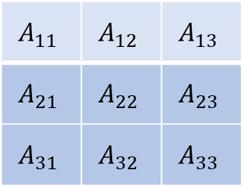
Déterminant 3x3:
$$A_{11}$$ | $$A_{12}$$ | $$A_{13}$$
$$A_{21}$$ | $$A_{22}$$ | $$A_{23}$$
$$A_{31}$$ | $$A_{32}$$ | $$A_{33}$$
$$det\left(A\right)=\left|A\right|={{\left(−1\right)}^{1+1}a}_{11}⋅\det\left(A_{11}\right)+{{\left(−1\right)}^{1+2}a}_{12}\det\left(A_{12}\right)+{{\left(−1\right)}^{1+3}a}_{13}\det\left(A_{13}\right)$$
$$=a_{11}⋅\det\left(A_{11}\right)−a_{12}\det\left(A_{12}\right)+a_{13}\det\left(A_{13}\right)$$

Slide 35
Déterminant 3x3:
$$A_{11}$$ | $$A_{12}$$ | $$A_{13}$$
$$A_{21}$$ | $$A_{22}$$ | $$A_{23}$$
$$A_{31}$$ | $$A_{32}$$ | $$A_{33}$$
$$a_{11}⋅\det\left(A_{11}\right)=a_{11}⋅(a_{22}⋅a_{33}−a_{32}⋅a_{23})$$

Slide 36
Déterminant 3x3:
$$A_{11}$$ | $$A_{12}$$ | $$A_{13}$$
$$A_{21}$$ | $$A_{22}$$ | $$A_{23}$$
$$A_{31}$$ | $$A_{32}$$ | $$A_{33}$$
$$a_{12}⋅\det\left(A_{12}\right)=a_{12}⋅(a_{21}⋅a_{33}−a_{31}⋅a_{23})$$

Slide 37
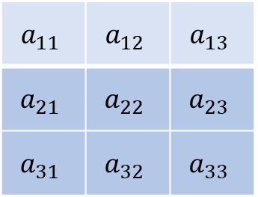
Déterminant 3x3:
$$a_{11}$$ | $$a_{12}$$ | $$a_{13}$$
$$a_{21}$$ | $$a_{22}$$ | $$a_{23}$$
$$a_{31}$$ | $$a_{32}$$ | $$a_{33}$$
$$a_{13}⋅\det\left(A_{13}\right)=a_{13}⋅(a_{21}⋅a_{32}−a_{31}⋅a_{22})$$

Slide 38
Déterminant 3x3:
$\det\left(A\right)=a_{11}⋅\det\left(A_{11}\right)−a_{12}\det\left(A_{12}\right)+a_{13}\det\left(A_{13}\right)$
= $a_{11}⋅\left(a_{22}⋅a_{33}−a_{32}⋅a_{23}\right)−a_{12}⋅\left(a_{21}⋅a_{33}−a_{31}⋅a_{23}\right)+a_{13}⋅(a_{21}⋅a_{32}−a_{31}⋅a_{22})$

Slide 39
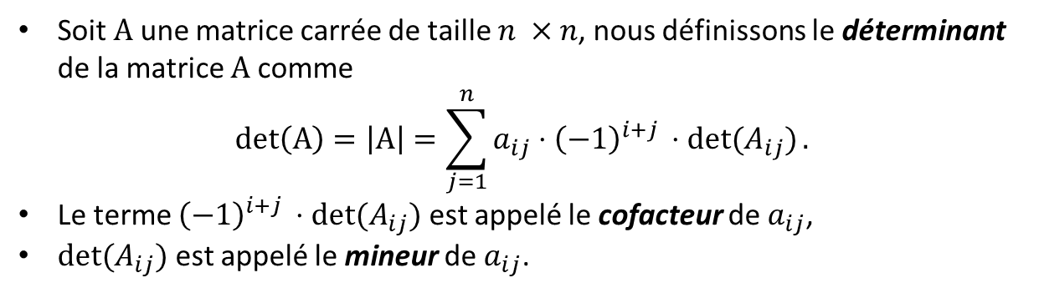
Déterminant général:
Soit $A$ une matrice carrée de taille $n ×n$, nous définissons le déterminant de la matrice $A$ comme
$$det\left(A\right)=\left|A\right|=\sum_{j=1}^{n}{{a_{ij}⋅\left(−1\right)}^{i+j }⋅det⁡(A_{ij})}.$$
Le terme ${\left(−1\right)}^{i+j }⋅det⁡(A_{ij})$ est appelé le cofacteur de $a_{ij}$,
$det⁡(A_{ij})$ est appelé le mineur de $a_{ij}$.

Slide 40




Exercices:
Calculer le déterminant des matrice suivantes
1. $det \left(\begin{matrix}1 & 2 \\ 3 & −4\end{matrix}\right)$
2.$det\left(\begin{matrix}1 & 2 \\ 3 & 6\end{matrix}\right)$
3. $det \left(\begin{matrix}1 & 4 & 0 \\ 2 & 5 & 0 \\ 3 & 6 & 0\end{matrix}\right)$
4. $det \left(\begin{matrix}−2 & 2 & −3 \\ −1 & 1 & 3 \\ 2 & 0 & −1\end{matrix}\right)$

Slide 41



Exercices – Solutions:
Calculer le déterminant des matrice suivantes
1. $det\left(\begin{matrix}1 & 2 \\ 3 & −4\end{matrix}\right)=−4 −6=−10$
2. $det \left(\begin{matrix}1 & 2 \\ 3 & 6\end{matrix}\right)=6 −6=0$
3. $det \left(\begin{matrix}1 & 4 & 0 \\ 2 & 5 & 0 \\ 3 & 6 & 0\end{matrix}\right)=0\det\left(A_{13}\right)−0\det\left(A_{23}\right)+0\det\left(A_{33}\right)=0$
4. $det \left(\begin{matrix}−2 & 2 & −3 \\ −1 & 1 & 3 \\ 2 & 0 & −1\end{matrix}\right)$
$$=−2\det\left(A_{12}\right)+1\det\left(A_{22}\right)+0\det\left(A_{23}\right)$$
$$=−2\left(1−6\right)+1\left(2+6\right)=10+8=18$$

Slide 42



Inversion de matrice
Soit une matrice carrée $A$ de dimension 2x2 et de déterminant non-nul, alors on calcule la matrice inverse $A^{−1}$ de façon suivante :
$$A^{−1}= \frac{1}{det⁡(A)}comA^{T}$$
Où $comA$ est la comtatrice (ou matrice adjointe) de $A$ et $comA^{T}$ est la transporée de la comatrice de $A$.

Slide 43




Comatrice de la matrice 2x2
$$A$$
$$comA$$
$$A_{11}$$ | $$A_{12}$$
$$A_{21}$$ | $$A_{22}$$
$$A_{22}$$ | $${−A}_{21}$$
$${−A}_{12}$$ | $$A_{11}$$

Slide 44



Comatrice de la matrice $n × n$
$comA_{ij}={\left(−1\right)}^{i+j}det⁡(A_{ij})$
$$+$$ | $$−$$ | $$+$$ | $$…$$ | $$…$$ | $${\left(−1\right)}^{1+n}$$
$$−$$ | $$+$$ | $$−$$ | $$…$$ | … | $${\left(−1\right)}^{2+n}$$
$$+$$ | $$−$$ | $$+$$ | $$…$$ | $$…$$ | $${\left(−1\right)}^{3+n}$$
$$…$$ | $$…$$ | $$…$$ | $$…$$ | … | $${\left(−1\right)}^{2+n}$$
$${\left(−1\right)}^{n+1}$$ | $${\left(−1\right)}^{n+2}$$ | $${\left(−1\right)}^{n+3}$$ | … | … | $${\left(−1\right)}^{n+n}$$

Slide 45



Comatrice de la matrice 3x3
$$A$$
$$comA$$
$$A_{11}$$ | $$A_{12}$$ | $$A_{13}$$
$$A_{21}$$ | $$A_{22}$$ | $$A_{23}$$
$$A_{31}$$ | $$A_{32}$$ | $$A_{33}$$
$$a_{22}a_{33}−a_{32}a_{13}$$ | $$−a_{21}a_{33}+a_{31}a_{13}$$ | $$a_{21}a_{32}−a_{31}a_{23}$$
$$−a_{12}a_{33}+a_{32}a_{13}$$ | $$a_{11}a_{33}+a_{31}a_{13}$$ | $$a_{11}a_{32}+a_{31}a_{12}$$
$$a_{12}a_{13}−a_{22}a_{13}$$ | $$−a_{11}a_{13}+a_{21}a_{13}$$ | $$a_{11}a_{22}−a_{21}a_{12}$$

Slide 46

Comatrice de la matrice 3x3
$$A$$
$$comA$$
$$A_{11}$$ | $$A_{12}$$ | $$A_{13}$$
$$A_{21}$$ | $$A_{22}$$ | $$A_{23}$$
$$A_{31}$$ | $$A_{32}$$ | $$A_{33}$$
$$a_{22}a_{33}−a_{32}a_{23}$$ | $$−a_{21}a_{33}+a_{31}a_{23}$$ | $$a_{21}a_{32}−a_{31}a_{22}$$
$$−a_{12}a_{33}+a_{32}a_{13}$$ | $$a_{11}a_{33}−a_{31}a_{13}$$ | $$−a_{11}a_{32}+a_{31}a_{12}$$
$$a_{12}a_{23}−a_{22}a_{13}$$ | $$−a_{11}a_{23}+a_{21}a_{13}$$ | $$a_{11}a_{22}−a_{21}a_{12}$$

Slide 47

Comatrice de la matrice 3x3
$$A$$
$$comA$$
$$A_{11}$$ | $$A_{12}$$ | $$A_{13}$$
$$A_{21}$$ | $$A_{22}$$ | $$A_{23}$$
$$A_{31}$$ | $$A_{32}$$ | $$A_{33}$$
$$a_{22}a_{33}−a_{32}a_{23}$$ | $$−a_{21}a_{33}+a_{31}a_{23}$$ | $$a_{21}a_{32}−a_{31}a_{22}$$
$$−a_{12}a_{33}+a_{32}a_{13}$$ | $$a_{11}a_{33}−a_{31}a_{13}$$ | $$−a_{11}a_{32}+a_{31}a_{12}$$
$$a_{12}a_{23}−a_{22}a_{13}$$ | $$−a_{11}a_{23}+a_{21}a_{13}$$ | $$a_{11}a_{22}−a_{21}a_{12}$$

Slide 48

Comatrice de la matrice 3x3
$$A$$
$$comA$$
$$A_{11}$$ | $$A_{12}$$ | $$A_{13}$$
$$A_{21}$$ | $$A_{22}$$ | $$A_{23}$$
$$A_{31}$$ | $$A_{32}$$ | $$A_{33}$$
$$a_{22}a_{33}−a_{32}a_{23}$$ | $$−a_{21}a_{33}+a_{31}a_{23}$$ | $$a_{21}a_{32}−a_{31}a_{22}$$
$$−a_{12}a_{33}+a_{32}a_{13}$$ | $$a_{11}a_{33}−a_{31}a_{13}$$ | $$−a_{11}a_{32}+a_{31}a_{12}$$
$$a_{12}a_{23}−a_{22}a_{13}$$ | $$−a_{11}a_{23}+a_{21}a_{13}$$ | $$a_{11}a_{22}−a_{21}a_{12}$$

Slide 49

Comatrice de la matrice 3x3
$$A$$
$$comA$$
$$A_{11}$$ | $$A_{12}$$ | $$A_{13}$$
$$A_{21}$$ | $$A_{22}$$ | $$A_{23}$$
$$A_{31}$$ | $$A_{32}$$ | $$A_{33}$$
$$a_{22}a_{33}−a_{32}a_{23}$$ | $$−a_{21}a_{33}+a_{31}a_{23}$$ | $$a_{21}a_{32}−a_{31}a_{22}$$
$$−a_{12}a_{33}+a_{32}a_{13}$$ | $$a_{11}a_{33}−a_{31}a_{13}$$ | $$−a_{11}a_{32}+a_{31}a_{12}$$
$$a_{12}a_{23}−a_{22}a_{13}$$ | $$−a_{11}a_{23}+a_{21}a_{13}$$ | $$a_{11}a_{22}−a_{21}a_{12}$$

Slide 50

Comatrice de la matrice 3x3
$$A$$
$$comA$$
$$A_{11}$$ | $$A_{12}$$ | $$A_{13}$$
$$A_{21}$$ | $$A_{22}$$ | $$A_{23}$$
$$A_{31}$$ | $$A_{32}$$ | $$A_{33}$$
$$a_{22}a_{33}−a_{32}a_{23}$$ | $$−a_{21}a_{33}+a_{31}a_{23}$$ | $$a_{21}a_{32}−a_{31}a_{22}$$
$$−a_{12}a_{33}+a_{32}a_{13}$$ | $$a_{11}a_{33}−a_{31}a_{13}$$ | $$−a_{11}a_{32}+a_{31}a_{12}$$
$$a_{12}a_{23}−a_{22}a_{13}$$ | $$−a_{11}a_{23}+a_{21}a_{13}$$ | $$a_{11}a_{22}−a_{21}a_{12}$$

Slide 51

Comatrice de la matrice 3x3
$$A$$
$$comA$$
$$A_{11}$$ | $$A_{12}$$ | $$A_{13}$$
$$A_{21}$$ | $$A_{22}$$ | $$A_{23}$$
$$A_{31}$$ | $$A_{32}$$ | $$A_{33}$$
$$a_{22}a_{33}−a_{32}a_{23}$$ | $$−a_{21}a_{33}+a_{31}a_{23}$$ | $$a_{21}a_{32}−a_{31}a_{22}$$
$$−a_{12}a_{33}+a_{32}a_{13}$$ | $$a_{11}a_{33}−a_{31}a_{13}$$ | $$−a_{11}a_{32}+a_{31}a_{12}$$
$$a_{12}a_{23}−a_{22}a_{13}$$ | $$−a_{11}a_{23}+a_{21}a_{13}$$ | $$a_{11}a_{22}−a_{21}a_{12}$$

Slide 52

Comatrice de la matrice 3x3
$$A$$
$$comA$$
$$A_{11}$$ | $$A_{12}$$ | $$A_{13}$$
$$A_{21}$$ | $$A_{22}$$ | $$A_{23}$$
$$A_{31}$$ | $$A_{32}$$ | $$A_{33}$$
$$a_{22}a_{33}−a_{32}a_{23}$$ | $$−a_{21}a_{33}+a_{31}a_{23}$$ | $$a_{21}a_{32}−a_{31}a_{22}$$
$$−a_{12}a_{33}+a_{32}a_{13}$$ | $$a_{11}a_{33}−a_{31}a_{13}$$ | $$−a_{11}a_{32}+a_{31}a_{12}$$
$$a_{12}a_{23}−a_{22}a_{13}$$ | $$−a_{11}a_{23}+a_{21}a_{13}$$ | $$a_{11}a_{22}−a_{21}a_{12}$$

Slide 53

Comatrice de la matrice 3x3
$$A$$
$$comA$$
$$A_{11}$$ | $$A_{12}$$ | $$A_{13}$$
$$A_{21}$$ | $$A_{22}$$ | $$A_{23}$$
$$A_{31}$$ | $$A_{32}$$ | $$A_{33}$$
$$a_{22}a_{33}−a_{32}a_{23}$$ | $$−a_{21}a_{33}+a_{31}a_{23}$$ | $$a_{21}a_{32}−a_{31}a_{22}$$
$$−a_{12}a_{33}+a_{32}a_{13}$$ | $$a_{11}a_{33}−a_{31}a_{13}$$ | $$−a_{11}a_{32}+a_{31}a_{12}$$
$$a_{12}a_{23}−a_{22}a_{13}$$ | $$−a_{11}a_{23}+a_{21}a_{13}$$ | $$a_{11}a_{22}−a_{21}a_{12}$$

Slide 54

Comatrice de la matrice 3x3
$$A$$
$$comA$$
$$A_{11}$$ | $$A_{12}$$ | $$A_{13}$$
$$A_{21}$$ | $$A_{22}$$ | $$A_{23}$$
$$A_{31}$$ | $$A_{32}$$ | $$A_{33}$$
$$a_{22}a_{33}−a_{32}a_{23}$$ | $$−a_{21}a_{33}+a_{31}a_{23}$$ | $$a_{21}a_{32}−a_{31}a_{22}$$
$$−a_{12}a_{33}+a_{32}a_{13}$$ | $$a_{11}a_{33}−a_{31}a_{13}$$ | $$−a_{11}a_{32}+a_{31}a_{12}$$
$$a_{12}a_{23}−a_{22}a_{13}$$ | $$−a_{11}a_{23}+a_{21}a_{13}$$ | $$a_{11}a_{22}−a_{21}a_{12}$$

Slide 55
Transposée d’une matrice
La transposée d’une matrice $A,$notée $A^{T}$, s’obtient par symétrie axiale par rapport à la diagonale principale. Autrement dit
$$A_{ij}^{T}=A_{ji}$$

Slide 56

Transposée d’une matrice
$$A_{11}$$ | $$A_{12}$$ | $$A_{13}$$ | $$…$$ | $$…$$ | $$A_{1n}$$
$$A_{21}$$ | $$A_{22}$$ | $$A_{23}$$ | $$…$$ | … | $$A_{2n}$$
$$A_{31}$$ | $$A_{32}$$ | $$A_{33}$$ | $$…$$ | $$…$$ | $$A_{3n}$$
$$…$$ | $$…$$ | $$…$$ | $$…$$ | $$…$$ | $$…$$
$$A_{m1}$$ | $$A_{m2}$$ | $$A_{m3}$$ | $$…$$ | $$…$$ | $$A_{mn}$$

Slide 57

$$A_{11}$$ | $$A_{21}$$ | $$A_{31}$$ | $$…$$ | $$A_{m1}$$
$$A_{12}$$ | $$A_{22}$$ | $$A_{32}$$ | … | $$A_{m2}$$
$$A_{13}$$ | $$A_{23}$$ | $$A_{33}$$ | $$…$$ | $$A_{m3}$$
$$…$$ | $$…$$ | $$…$$ | $$…$$ | $$…$$
$$…$$ | $$…$$ | $$…$$ | $$…$$ | $$…$$
$$A_{1n}$$ | $$A_{2n}$$ | $$A_{3n}$$ | $$…$$ | $$A_{nm}$$

Slide 58







Comatrice transposée $comA^{T}$
$$A$$
$$comA^{T}$$
$$A_{11}$$ | $$A_{12}$$
$$A_{21}$$ | $$A_{22}$$
$$A_{22}$$ | $${−A}_{12}$$
$${−A}_{21}$$ | $$A_{11}$$
$$A_{11}$$ | $$A_{12}$$ | $$A_{13}$$
$$A_{21}$$ | $$A_{22}$$ | $$A_{23}$$
$$A_{31}$$ | $$A_{32}$$ | $$A_{33}$$
$$a_{22}a_{33}−a_{32}a_{23}$$ | $$−a_{12}a_{33}+a_{32}a_{13}$$ | $$a_{12}a_{23}−a_{22}a_{13}$$
$$−a_{21}a_{33}+a_{31}a_{23}$$ | $$a_{11}a_{33}−a_{31}a_{13}$$ | $$−a_{11}a_{23}+a_{21}a_{13}$$
$$a_{21}a_{32}−a_{31}a_{22}$$ | $$−a_{11}a_{32}+a_{31}a_{12}$$ | $$a_{11}a_{22}−a_{21}a_{12}$$

Slide 59





Exercices:
Calculer la matrice inverse des matrices suivantes
1. ${\left(\begin{matrix}1 & 2 \\ 3 & −4\end{matrix}\right)}^{−1}$
2. ${\left(\begin{matrix}1 & 2 \\ 3 & 6\end{matrix}\right)}^{−1}$
3. ${\left(\begin{matrix}1 & 4 & 0 \\ 2 & 5 & 0 \\ 3 & 6 & 0\end{matrix}\right)}^{−1}$
4. ${\left(\begin{matrix}−2 & 2 & −3 \\ −1 & 1 & 3 \\ 2 & 0 & −1\end{matrix}\right)}^{−1}$
5. ${\left(\begin{matrix}−2 & 2 & −3 \\ −1 & 1 & 3 \\ 2 & 0 & −1\end{matrix}\begin{matrix} 3 \\ −1 \\ 2\end{matrix}\right)}^{−1}$

Slide 60




Exercices - Solutions:
Calculer la matrice inverse des matrices suivantes
1. ${\left(\begin{matrix}1 & 2 \\ 3 & −4\end{matrix}\right)}^{−1}=\left(\begin{matrix}0.4 & 0.2 \\ 0.3 & −0.1\end{matrix}\right)$
2. ${\left(\begin{matrix}1 & 2 \\ 3 & 6\end{matrix}\right)}^{−1}$ => cette matrice n’est pas inversible car $\det\left(A\right)=0$.
3. ${\left(\begin{matrix}1 & 4 & 0 \\ 2 & 5 & 0 \\ 3 & 6 & 0\end{matrix}\right)}^{−1}$ => cette matrice n’est pas inversible car $\det\left(A\right)=0$.
4. ${\left(\begin{matrix}−2 & 2 & −3 \\ −1 & 1 & 3 \\ 2 & 0 & −1\end{matrix}\right)}^{−1}=\left(\begin{matrix}−1/18 & 1/9 & 0.5 \\ 5/18 & 4/9 & 0.5 \\ −1/9 & 2/9 & −1\end{matrix}\right)$
5. ${\left(\begin{matrix}−2 & 2 & −3 \\ −1 & 1 & 3 \\ 2 & 0 & −1\end{matrix}\begin{matrix} 3 \\ −1 \\ 2\end{matrix}\right)}^{−1}$ => cette matrice n’est pas inversible car pas carrée.

